Slide 1
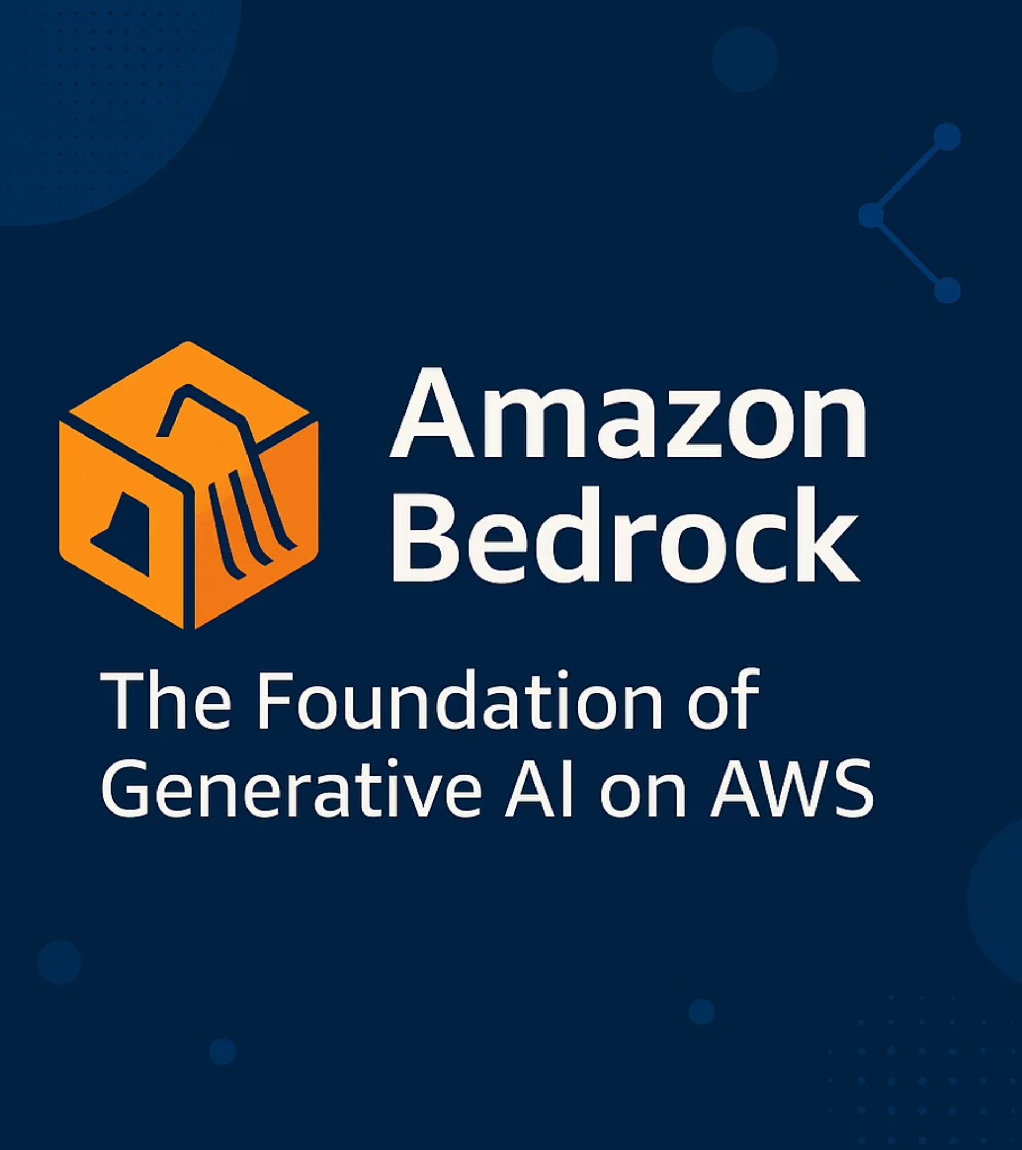
AWS Bedrock Masterclass
Building Practical Generetive AI Applications with AWS
Welcome to a hands-on, beginner-friendly Masterclass to deep dive into Amazon Bedrock and the AWS services required to build Generative AI apps.
This masterclass will equip you with practical knowledge to harness Generative AI for automation and data-driven decision-making using one of the safest, enterprise-ready platforms available today.
By -
Devdatta Supnekar

Slide 2

What You'll Master Today
Core GenAI Concepts
Bedrock Ecosystem
Learn what Generative AI, Foundation Models, LLMs, tokens, and context length truly mean — not just definitions, but how they impact real applications and shape your development decisions.
Understand why AWS created Bedrock, what problems it solves, and how tools like Agents, Knowledge Bases, and Guardrails expand an LLM's capability beyond basic text generation.
Essential AWS Services
Practical Mindset
Master IAM, S3, Lambda, EC2 — learn how these cloud components support a GenAI workflow and where they fit into the architecture for production-ready applications.
By the end, you'll understand what a real GenAI project looks like: data flow, application flow, model selection, prompt strategy, and deployment considerations.

Slide 3


What is Generative AI?
The Core Idea
Generative AI focuses on creating new content — not just predicting values. It learns patterns from huge datasets and uses them to produce text, images, code, and insights that didn't exist before.
How it Behaves
Instead of giving a single number (like traditional ML), GenAI can:
Formulate coherent paragraphs
Explain complex reasoning step-by-step
Summarise complex documents into digestible insights
Write or fix code in multiple languages
Why It's Transformative
Generate creative design ideas on demand
It allows people to interact with data, documents, and systems using natural language, making technology accessible to non-technical users as well. No more complex interfaces or specialized training required.
Micro Example: "Explain this PDF in simple terms" → GenAI reads → finds key points → produces a digestible summary. No manual feature engineering. No custom ML pipeline needed.

Slide 4
Generative AI vs Traditional ML
Understanding the fundamental differences helps you choose the right approach for your use case. While both are powerful, they solve different classes of problems.
Area
Traditional ML
Generative AI
Primary Output
A number, class, or probability
Full sentences, explanations, images, code
Data Type
Mostly structured (tables)
Unstructured (text, PDFs, images)
Training Approach
Custom per problem
One pre-trained model → many tasks
Interaction Style
Inputs/outputs
Natural language dialogue
Development Time
Weeks to months of training
Hours to days with prompting
The Traditional Path
The GenAI Advantage
Requires collecting data → cleaning → feature engineering → training → deployment. Time-consuming but precise for specific prediction tasks.
Skips most setup — the model already knows language, structure, reasoning patterns, and general world knowledge. Perfect for understanding, reasoning, summarisation, creativity, and decision support.

Slide 5
Foundation Models: Your AI Building Blocks
Foundation Models = Base Intelligence Layer
They are large pre-trained models built on trillions of tokens and multi-modal data. Instead of training from scratch, you simply "use" them through prompts — like accessing a vast library of knowledge rather than writing every book yourself.
Generalise Across Tasks
Natural Language Instructions
Handle QA, summarisation, reasoning, translation, and more without retraining
Understand what you ask in plain English — no special syntax required
Simple to Complex Workflows
Long Context Handling
Support everything from one-line questions to multi-step reasoning chains
Process extensive inputs depending on the model's context window capacity
How You Actually Use Them
You don't train them yourself — you guide them with prompts, examples, or additional context (like RAG - Retrieval Augmented Generation). They become the "brain" behind your GenAI application, handling the heavy lifting of understanding and generation.
A Foundation Model can read your 40-page PDF and extract actionable insights without writing a custom NLP pipeline. That's the power of pre-trained intelligence.

Slide 6

Types of Foundation Models
Different models excel at different tasks. Choosing the right category is essential for building effective GenAI applications.
Text / Chat Models
Image Generation Models
Embedding Models
Designed for conversation, summarisation, coding, reasoning, and document Q&A. These are your go-to for most business applications.
Used for creating visuals, product images, concept art, design variations, and marketing materials from text descriptions.
Convert text into numerical vectors for semantic search, RAG systems, clustering, and similarity matching. Critical for knowledge retrieval.
Examples: Stable Diffusion XL (SDXL), Amazon Titan Image Generator
Examples: Claude (deep reasoning), Llama 3.1 (fast, open), Mistral Large (efficient), Amazon Titan Text (AWS-native)
Examples: Titan Embeddings, Cohere Embed
Pro Tip: Many production GenAI systems use multiple model types together — embeddings for search, text models for generation, and sometimes image models for visual content.

Slide 7
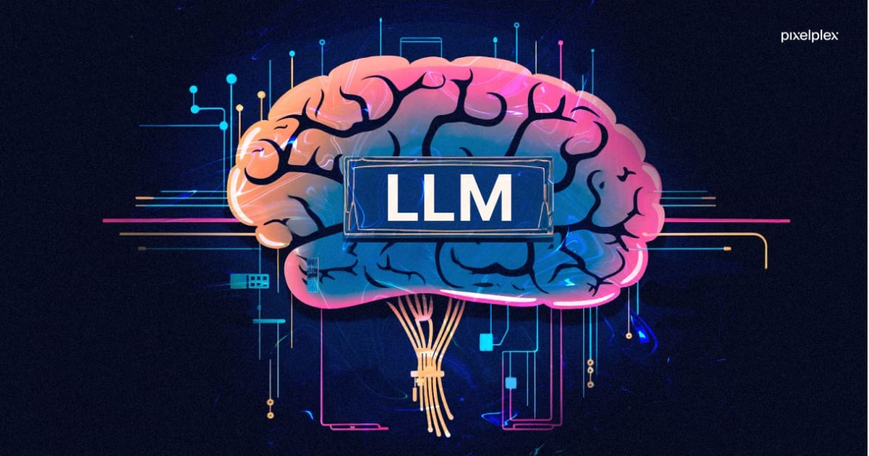
Understanding LLMs
What is an LLM?
Core Capabilities
A Large Language Model is a neural network trained on massive amounts of text to understand and generate human-like language. Think of it as a general-purpose text engine that has read millions of books, articles, and code repositories.
Understand Instructions
Parse complex questions and multi-step requests in natural language
Generate Responses
Produce structured or detailed answers tailored to your needs
Write & Debug Code
Create functional code in multiple languages and fix bugs
Summarise Content
Condense long documents into key insights and actionable points
Reason Step-by-Step
Provide logical reasoning chains when prompted correctly
An LLM is like having a knowledgeable assistant who has read everything on the internet and can help you with almost any text-based task through simple conversation.

Slide 8




How LLMs Work: The Magic Behind the Scenes
Understanding the basic architecture helps you write better prompts and debug issues when things don't work as expected.
Tokenization
Attention Mechanism
Input text is split into smaller units called tokens — the model's "words". This breaking down process allows the model to handle any language or special characters.
The model identifies relationships between words — "what depends on what". This is where context and meaning emerge from raw text.
Transformer Layers
Generation
Multiple layers process meaning, context, and patterns. Each layer refines understanding, building from simple patterns to complex reasoning.
The model predicts the next token repeatedly until the output is complete. Each prediction considers all previous tokens for coherence.
In essence: LLMs learn patterns from training data → use those patterns to understand your input → then generate appropriate responses token by token. It's probability and pattern matching at massive scale.

Slide 9
Tokens: The Currency of LLMs
What Are Tokens?
Why Tokens Matter
Tokens are the smallest text units the model processes — like Lego pieces used to build full sentences. Understanding tokens is crucial because they impact everything about your GenAI application.
1
Cost Control
Most LLM APIs charge per token — both input and output. More tokens = higher costs.
Simple Example
2
Speed Impact
More tokens take longer to process. Optimising token usage improves response time.
"Machine learning is fun"→ approximately 4–5 tokens
"Generative AI revolutionizes automation"→ approximately 6–7 tokens
3
Context Limits
Every model has a maximum token capacity. Exceeding it means truncation or errors.
Generally, one token ≈ 4 characters or ¾ of a word in English. Other languages may tokenize differently.

Slide 10
Context Length: Your Model's Memory
Context length defines the maximum number of tokens a model can read and generate in one interaction. Think of it as the model's working memory — everything it can "see" and "remember" during a conversation.
Why Context Length Matters
Document Size Control
Reasoning Depth
Accuracy Improvement
Determines how large a document you can pass to the model for analysis. Larger context = ability to process entire research papers or codebases.
More context allows the model to maintain coherence over longer conversations and consider more information when reasoning.
Longer context windows enable more accurate document-based answers since the model can reference the full source material.
Context Length Examples
32K
200K
1M
Standard Chat
Research Papers
Full Books
Good for typical conversations and short document analysis
Handle academic papers, technical documentation, long reports
Claude 3.5 Sonnet — process entire books, codebases, or massive datasets
Pro Tip: Longer context doesn't always mean better results. Sometimes focused, relevant context with good prompt engineering outperforms simply dumping everything into a large context window.

Slide 11

Temperature & Top-P: Fine-Tuning LLM Outputs
These two parameters are your primary controls for influencing the predictability and creativity of an LLM's responses. Mastering them is key to getting the desired output for any task.
Temperature: Creativity Control
Top-P: Response Variety Control
This parameter dictates the randomness of the model's next token prediction. Higher values lead to more diverse and imaginative text, while lower values produce more focused and deterministic responses.
Top-P (or nucleus sampling) focuses on a subset of the most probable tokens for the next word. It allows for more focused, yet still somewhat varied, generation compared to purely random sampling.
Lower Temperature: Factual, structured, precise outputs (e.g., technical writing, data extraction).
Low Top-P: Safer, predictable outputs, sticking to the most probable next words.
Higher Temperature: More creative, varied, and exploratory outputs (e.g., brainstorming, story generation).
High Top-P: More diverse, exploratory responses, considering a wider range of probable tokens.
Use low for technical tasks and high for creative tasks.
Often used in conjunction with Temperature for nuanced control over output diversity.
Together: Temperature and Top-P define how "safe or creative" the model behaves, allowing you to fine-tune its persona and output style to specific application needs.

Slide 12
AWS Cloud Basics
Generative AI applications require robust infrastructure for storage, compute, networking, and identity management. AWS provides all of these as fully managed services, simplifying development and deployment.
IAM
S3
Lambda
Defines who can securely access which resources.
Scalable storage for files, data lakes, and datasets.
Run code without provisioning or managing servers.
EC2
VPC
Virtual servers for running your applications.
Isolated virtual networks for cloud resources.
AWS Bedrock leverages this infrastructure, enabling you to build secure, scalable, and enterprise-ready GenAI applications with ease.

Slide 13

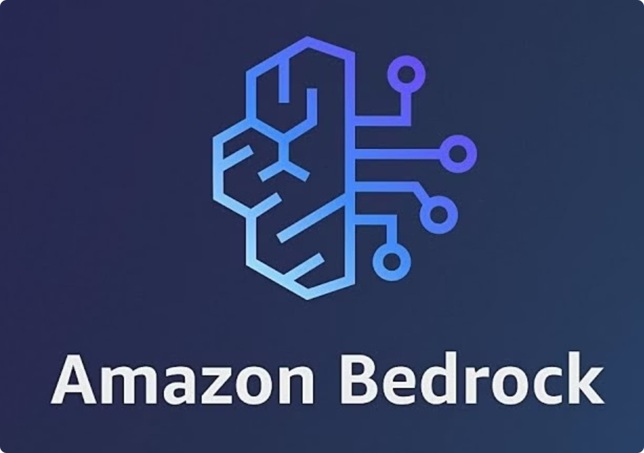
What is Amazon Bedrock?
Amazon Bedrock is a fully managed Generative AI service that simplifies access to various top-quality Foundation Models (FMs) and Large Language Models (LLMs) through a single, unified API.
What Bedrock Provides
Unified Model Access
Seamlessly integrate multiple LLMs and image generation models from leading providers.
Secure & Private Environment
Ensures your data remains confidential and is never used for model training.
Flexible Pricing
Utilise a pay-as-you-go model, optimising costs based on usage.
Enterprise-Grade Reliability
Leverage AWS's robust infrastructure for high availability and scalability.
Why It Exists
Bedrock aims to make Generative AI development simple, secure, and production-ready. It abstracts away the complexities of managing GPUs, infrastructure, and custom model pipelines, allowing developers to focus on innovation.

Slide 14
How Bedrock Works: Simplified
Amazon Bedrock streamlines the development of generative AI applications by managing the underlying infrastructure and providing a clear, intuitive interface.
The Basic Flow
Your App Sends Prompt
Bedrock Selects Model
Your application sends a request (prompt) to Bedrock with your desired input.
Bedrock dynamically selects the pre-trained foundation model you specified for the task.
Model Processes Input
Bedrock Returns Response
The selected foundation model processes your prompt, generating a response.
Bedrock sends the generated output back to your application.
What You Don’t Manage
Optional Add-ons
Bedrock abstracts away the complexities of infrastructure management, letting you focus on innovation.
Extend Bedrock's core capabilities with integrated features for advanced use cases.
Knowledge Bases (RAG): Ground models with proprietary data.
Hardware provisioning
Agents (Tool Execution): Enable models to perform multi-step tasks.
GPU optimisation
Guardrails (Safety): Implement content moderation and safety policies.
Scaling infrastructure
Model hosting
Server management

Slide 15
Bedrock Model Categories
Amazon Bedrock simplifies access to a diverse range of foundational models, each specialised for different generative AI tasks. Understanding these categories is crucial for selecting the right tool for your application.
Text Models
Image Models
Embedding Models
Used for natural language tasks like question answering, summarisation, chatbots, complex reasoning, document analysis, and code generation.
Designed for visual content generation, editing, creating product shots, artistic compositions, and creative design concepts.
Converts text into numerical vector representations (embeddings) for efficient information retrieval, search, data clustering, and semantic similarity tasks.
Examples: Claude, Llama, Titan Text, Mistral.
Examples: SDXL, Titan Image.
Examples: Titan Embeddings, Cohere Embeddings.
Why Categories Matter
Each model category addresses a distinct problem within a Generative AI workflow, allowing developers to leverage specialised capabilities for optimal results across diverse applications.

Slide 16
Text Models on Bedrock: A Comparison
Amazon Bedrock provides access to a variety of powerful text-based Foundation Models from leading providers. Each model offers unique strengths tailored for different applications.
Claude (Anthropic)
Llama (Meta)
Noted for strong reasoning and extensive context windows, making it ideal for document analysis, summarisation, and complex query processing.
An open, fast, and lightweight model suitable for coding assistance, chat applications, and research. Offers flexibility for fine-tuning.
Mistral
Titan Text (AWS)
Valued for its efficiency and rapid response times, perfect for real-time applications, quick text generation, and cost-effective deployment.
AWS-native, designed for enterprise-grade tasks, offering reliability and deep integration within the AWS ecosystem for a range of text generation needs.
Summary
When selecting a text model, consider factors like reasoning capabilities, context length requirements, speed, and cost-effectiveness to align with your specific application goals.

Slide 17

Image Models on Bedrock: A Comparison
Amazon Bedrock provides access to advanced image generation models, enabling creative professionals and businesses to produce high-quality visual content with ease.
Titan Image Generator
Specialises in clean, controlled image generation, perfect for high-quality commercial assets. Ideal for product imagery, marketing creatives, and branding assets.
Stability Diffusion XL (SDXL)
An industry-leading AI art model known for creative freedom and diverse artistic styles. Great for concept art, visual design, illustrations, and supports flexible variations.
Where They Are Useful
E-commerce for compelling product visuals.
Marketing teams for engaging campaigns and creatives.
Creative agencies for rapid ideation and design prototyping.
Product prototyping for visualising concepts before development.

Slide 18
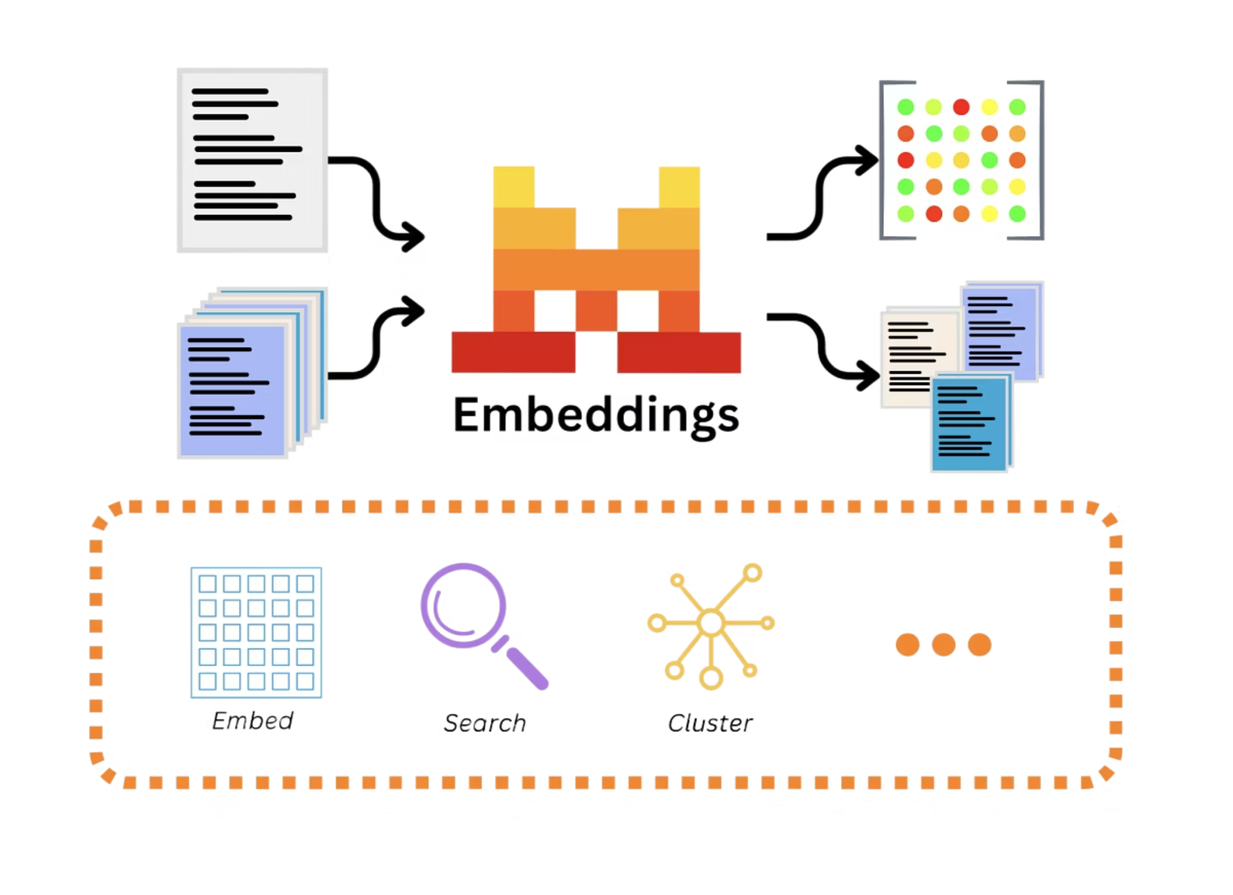
Embedding Models on Bedrock: Understanding Semantic Meaning
At its core, embeddings convert unstructured text into numerical vector representations. These vectors capture the semantic meaning of the text, allowing machines to "understand" and compare concepts beyond mere keywords.
Why Embeddings Matter
Machine Comprehension
Machines cannot directly process human language, but they excel at numerical comparisons. Embeddings bridge this gap.
Enhanced Search
Enable semantic search where results are based on meaning, not just exact keyword matches, revolutionising information retrieval.
RAG Pipelines
Power Retrieval Augmented Generation (RAG) by efficiently finding relevant documents for LLMs to use as context.
Data Organisation
Facilitate clustering, grouping, and recommendation systems by identifying related documents or data points.
A Simple Use Case
If you search for "invoice overdue" using embeddings, the system won't just look for those exact words. It could return all documents related to payments, collections, or outstanding bills, even if the word "invoice" isn't explicitly present.

Slide 19
Knowledge Bases in Bedrock (RAG)
Knowledge Bases (KB) in Amazon Bedrock enable Retrieval-Augmented Generation (RAG), allowing your foundation models to interact with and generate responses based on your proprietary documents stored in S3.
How Knowledge Bases Streamline RAG
Document Ingestion & Chunking
Semantic Embedding Creation
Your documents are automatically split into smaller, manageable chunks, optimising them for retrieval and context integration.
Each chunk is transformed into a numerical vector (embedding) using an embedding model, capturing its semantic meaning.
Vector Database Indexing
Intelligent Retrieval & Generation
These embeddings are then indexed in a vector database, creating a searchable repository of your enterprise knowledge.
When a query is made, relevant chunks are retrieved from the vector database and used to augment the LLM's response, providing accurate and context-rich answers.
Why It's Essential
Knowledge Bases allow you to upload PDFs, text files, manuals, or reports and make them instantly queryable with natural language. This empowers your applications with accurate, up-to-date, and domain-specific information, all without the need for managing complex infrastructure.

Slide 20

RAG Process: How Retrieval-Augmented Generation Works
Retrieval-Augmented Generation (RAG) empowers LLMs to access and integrate external, up-to-date information, moving beyond their pre-trained knowledge.
How RAG Works Step-by-Step
User Query
Knowledge Base Retrieval
The process begins with a user's natural language question or prompt submitted to your application.
The Bedrock Knowledge Base searches your proprietary data sources for the most semantically relevant document chunks.
Contextual Augmentation
LLM Generates Response
These retrieved chunks are combined with the original user query, creating an enriched, grounded prompt for the LLM.
The LLM then generates an accurate and contextual answer, leveraging both its inherent knowledge and your specific data.
Why RAG Improves Accuracy
RAG significantly reduces the risk of hallucinations by ensuring the LLM's responses are grounded in verifiable, real-time data from your documents, rather than relying solely on its pre-trained, potentially outdated, knowledge.
Example Scenario
If a user asks, "What is the interest rate mentioned in policy document X?", RAG will retrieve the specific section from "policy document X" that discusses interest rates, and the LLM will generate an answer based only on that factual text.

Slide 21
What Are Generative AI Agents?
In the world of Generative AI, an Agent is more than just a large language model (LLM) that responds to prompts. Think of it as an AI system designed to understand complex goals, break them down into actionable steps, and then execute those steps using various tools to achieve a specific outcome.
More Than Just Talking
Why We Need Them
Where They Are Used
An agent gives an LLM the ability to think, plan, and act. It can reason through a problem, decide what information or tools it needs, and then use those tools to perform tasks, much like a human would.
LLMs alone are powerful but often lack external capabilities like internet access or software control. Agents bridge this gap, allowing LLMs to interact with the outside world, perform calculations, fetch real-time data, or even update databases.
Agents are ideal for automating multi-step processes. Examples include sophisticated customer support (retrieving specific customer info and drafting emails), data analysis (querying databases and generating reports), or even managing complex IT operations.
Essentially, an agent transforms a static language model into a dynamic, problem-solving entity that can handle more intricate, real-world tasks autonomously.

Slide 22

What Are Bedrock Agents?
Bedrock Agents empower Foundation Models to go beyond mere answering, enabling them to intelligently perform complex actions, integrate with external systems, and execute multi-step workflows autonomously.
Key Capabilities of Bedrock Agents
Intelligent Planning
The LLM autonomously determines the optimal sequence of steps to accomplish a given task, breaking down complex requests into manageable actions.
Tool Execution
Agents can invoke AWS Lambda functions, external APIs, or custom functions, allowing them to interact with real-world systems and data sources.
Multi-step Automation
Complex workflows are executed step-by-step, transforming multi-stage operations into seamless, automated processes.
Structured Reasoning
They break down intricate tasks into logical sub-steps, enabling systematic problem-solving and robust task completion.
Why They Matter
Bedrock Agents elevate an LLM from a simple chatbot to a powerful, task-performing system. For example, instead of just answering "What is the sales report?", an agent can actually "Generate sales report → fetch data from CRM → clean data → create summary document → email summary to manager."

Slide 23
Bedrock Agent Workflow: From Instruction to Action
Bedrock Agents orchestrate complex tasks by transforming user instructions into a series of intelligent, automated actions.
User Instruction
The workflow begins with a natural language prompt from the user, detailing the desired outcome (e.g., "Check stock price and give summary").
LLM Creates a Plan
The Agent's underlying LLM autonomously interprets the instruction and devises a step-by-step execution plan, identifying necessary tools and actions.
Tool Invocation
Based on the plan, the Agent invokes relevant APIs, AWS Lambda functions, or other custom tools to interact with external systems and retrieve data.
Process Results
The LLM receives and processes the outputs from the invoked tools, interpreting the data and integrating it into its reasoning.
Final Answer
The Agent synthesises the processed information into a clear, concise, and actionable response, delivering it back to the user.
Key Insight
Bedrock Agents seamlessly combine the reasoning capabilities of Large Language Models with the power of external tools, enabling sophisticated, automated workflows that go beyond simple question-answering.

Slide 24
What Are Guardrails?
Guardrails are pre-defined policies that control and restrict a Foundation Model's behaviour, ensuring safe, responsible, and domain-appropriate outputs that align with specific business objectives.
What You Can Control
1
2
Content Blocking
Safety Filtering
Proactively prevent the generation of responses related to specific, undesirable topics or sensitive subjects.
Automatically detect and filter out harmful, toxic, or biased content to maintain responsible AI interactions.
3
4
Style & Tone Enforcement
Hallucination Prevention
Mandate specific brand voices, formal tones, or required stylistic elements in all generated text.
Integrate grounding checks against known data sources to minimise factual inaccuracies and ensure veracity.
Why It's Important
Businesses need generative AI to operate consistently, safely, and in full compliance with internal guidelines and external regulations. Guardrails are crucial for enforcing these critical parameters.

Slide 25

AWS IAM (Identity & Access Management)
AWS IAM is the cornerstone service for managing secure access to your AWS resources, defining precisely who can access what and under what conditions.
User
A persistent identity for an individual or application needing AWS access.
Role
Temporary permissions granted to services or trusted entities for specific tasks.
Policies
JSON documents detailing allowed or denied actions on specified AWS resources.
Groups
Collections of IAM users, simplifying permission management at scale.
Why It Matters for Bedrock
For your Bedrock applications to function securely, IAM is indispensable. You must assign precise permissions for models to access data in S3, invoke Lambda functions, or integrate with other AWS services. IAM provides the granular control necessary to ensure authorised interactions and prevent security vulnerabilities.
IAM ensures that all your Bedrock operations are secure, controlled, and compliant, preventing unauthorised access and maintaining data integrity within your generative AI workflows.

Slide 26

Root User vs IAM User
Root User
IAM User
The root user holds complete administrative control over your AWS account and is the identity created upon initial account setup.
An IAM (Identity and Access Management) user is an identity created within your AWS account with specific, controlled permissions.
Full Control: Unrestricted access to all resources and services.
Daily Operations: Ideal for everyday tasks like development, administration, and resource management.
Limited Use: Should be used exclusively for initial setup, managing billing, and enabling Multi-Factor Authentication (MFA).
Limited Permissions: Access is restricted to only what's necessary, significantly reducing the potential impact of a security breach.
High Risk: Compromise of the root user poses an extremely high security risk to your entire AWS infrastructure.
Safe for Bedrock: Securely interact with services like Bedrock, S3, and Lambda by assigning only the required permissions.
Best Practice
Never use the root account for daily development or routine tasks. Always create dedicated IAM users with the principle of least privilege, granting only the permissions essential for their role. This significantly enhances your AWS account's security posture.

Slide 27
Amazon S3 (Simple Storage Service)
Amazon S3 is a highly durable, scalable, and secure object storage service designed to store and retrieve any amount of data from anywhere on the web. It's the backbone for many modern applications, including those powered by Generative AI.
How S3 Connects to Bedrock
RAG Data Repository
Image Asset Storage
GenAI Application Logging & Output
S3 serves as the primary repository for vast amounts of unstructured data like PDFs, text documents, and manuals. This data is crucial for Retrieval Augmented Generation (RAG) to ground Bedrock models with up-to-date and domain-specific information.
It securely stores large volumes of image data, which can then be seamlessly accessed by Bedrock's image generation and analysis models. This enables rapid prototyping and deployment of vision-based GenAI applications.
S3 centralises the storage of application logs, model outputs, and all generated content from your Bedrock applications. This provides a persistent and scalable solution for auditing, analysis, and further processing of your GenAI workflows.
Why S3 Matters
S3 isn't just a storage solution; it becomes the central, foundational storage layer in almost all modern Generative AI workflows. Its unparalleled scalability, reliability, and seamless integration with other AWS services make it indispensable for building robust and high-performing Bedrock applications.

Slide 28
AWS Lambda (Serverless Functions)
AWS Lambda is a serverless, event-driven compute service that lets you run code for virtually any type of application or backend service without provisioning or managing servers.
How It's Used With Bedrock
Agent Tools
Functions can act as custom tools for Bedrock Agents, enabling them to interact with external systems, perform calculations, or retrieve specific data.
Document Processing
Automate the pre-processing of documents before their ingestion into Bedrock Knowledge Bases, such as text extraction, clean-up, or format conversion.
External Data Fetching
Dynamically fetch real-time data from external APIs or databases to enrich prompts or responses generated by Foundation Models.
Input Validation
Implement custom logic to validate user inputs before they reach the Foundation Model, ensuring data quality and adherence to business rules.
The Benefit
Lambda lets you seamlessly embed dynamic "logic blocks" into your Generative AI applications, extending their capabilities without the operational overhead of managing dedicated servers. This enables more intelligent, responsive, and integrated GenAI solutions.

Slide 29
EC2 (Elastic Compute Cloud)
Amazon Elastic Compute Cloud (EC2) provides resizable compute capacity in the cloud. It allows you to rent virtual servers, known as instances, giving you comprehensive control over your computing environment, from operating system to application stack.
What EC2 Provides
GenAI Use-Cases
Configurable virtual machines (instances).
Hosting backend APIs for Bedrock.
Full control over compute environment.
Running external vector databases.
Scalability to meet varying demands.
Deploying dashboards/web interfaces.
Heavy data processing for models.
Insight: EC2 is for full control and persistent compute needs, while Lambda is ideal for event-driven, short-duration, serverless tasks.

Slide 30
Bedrock Pricing (Easy Breakdown)
Understanding the cost structure of Amazon Bedrock is crucial for optimising your Generative AI workloads and managing budgets effectively.
How Billing Works
You Pay For:
No Charges For:
Input Tokens: Tokens sent to the model for processing.
Model Hosting: No separate charges for hosting the foundation models.
Output Tokens: Tokens generated by the model in response.
Image Generation: Billed per image request.
Infrastructure: Bedrock handles the underlying infrastructure, so no compute or storage costs there.
RAG Indexing: Costs associated with processing and indexing data for Knowledge Bases.
Idle Time: You only pay when the models are actively processing requests.
Agent Executions: Charged for each tool call made by Bedrock Agents.
Key Tip: To optimise costs, always choose the right model for your specific task and keep your prompts as concise and efficient as possible.

Slide 31






End-to-End GenAI Architecture
Building a robust Generative AI application involves orchestrating multiple AWS services. This diagram illustrates a typical workflow, demonstrating how different components integrate to create a complete solution.
User Interface
The entry point for user interaction, typically a web application, mobile app, or a Streamlit interface, collecting user prompts or requests.
Backend API
An API layer (often powered by AWS Lambda or EC2) receives the request from the UI, validates it, and routes it to the appropriate Bedrock model.
Bedrock Model
The core Generative AI model processes the input prompt, performing tasks like text generation, summarisation, or image creation based on its capabilities.
Knowledge Base (Optional)
For RAG implementations, a Knowledge Base provides relevant context and domain-specific information to the Bedrock model, ensuring grounded and accurate responses.
S3 Storage
S3 serves as a central repository for storing user documents, model outputs, application logs, and any other persistent data required by the GenAI system.
Result: This architecture yields a highly scalable, modular, and secure GenAI system, with each component leveraging AWS cloud-native services for optimal performance and reliability.

Slide 32
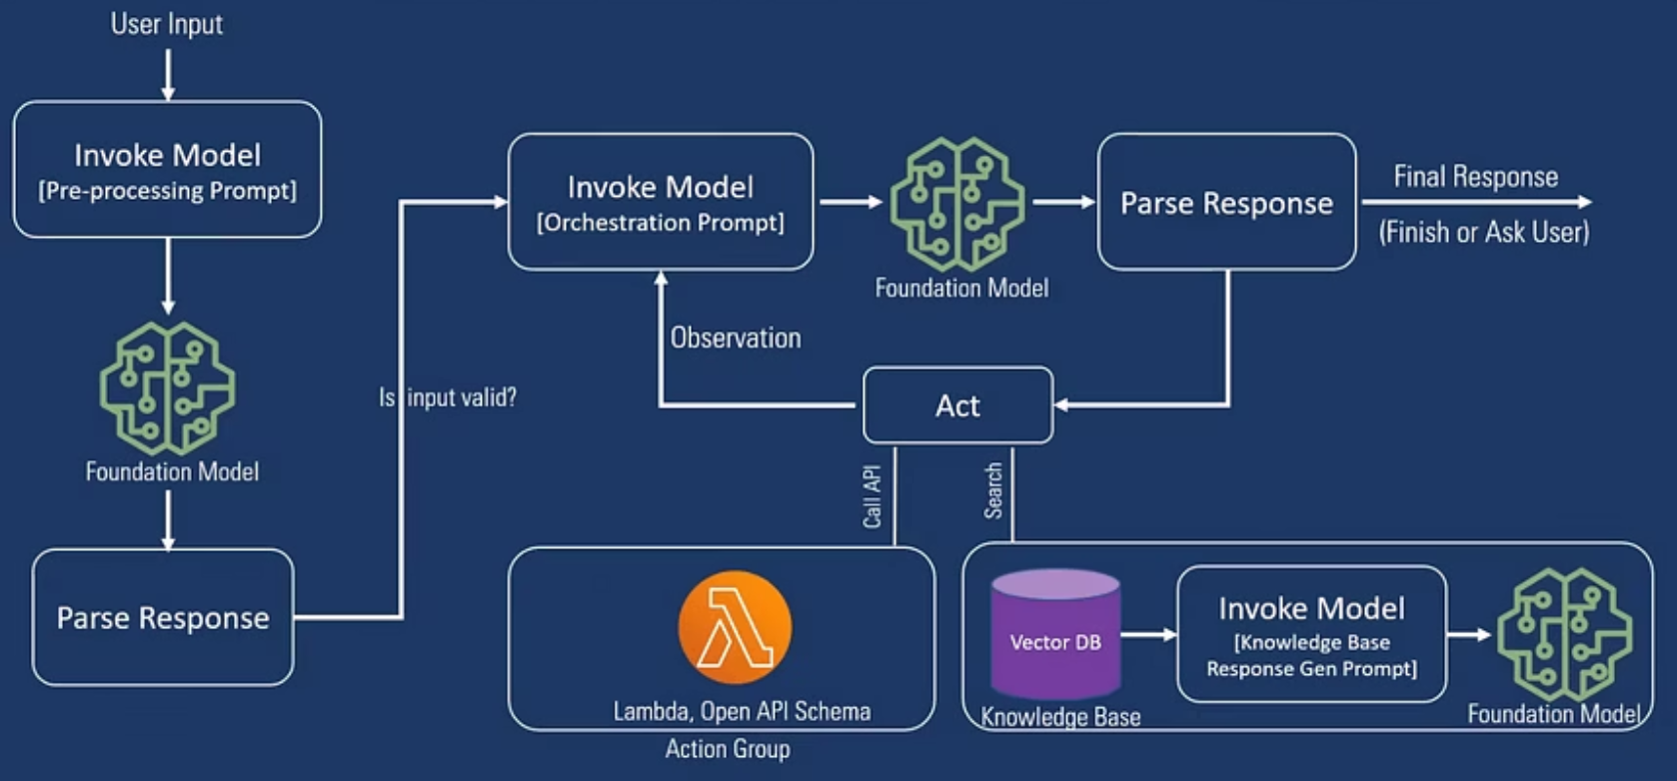
Architecture Diagram of RAG

Slide 33
Real-World GenAI Use Cases
Amazon Bedrock empowers organisations to build and deploy innovative Generative AI applications across various domains. Here are some compelling real-world use cases:
Document Intelligence
Upload extensive PDFs (reports, policies, manuals) to instantly generate summaries, extract critical insights, and efficiently answer specific questions about the content.
Customer Support Assistants
Deploy LLM-powered chatbots that accurately understand user queries, retrieve relevant answers, and automate troubleshooting processes, significantly enhancing customer experience.
Internal Knowledge Assistants
Enable teams to navigate and search vast internal knowledge bases using natural language, providing accurate, context-rich responses by leveraging Retrieval-Augmented Generation (RAG).
Code & Data Assistants
Automate tedious development tasks such as generating SQL queries, cleaning dataframes, writing Python functions, and streamlining complex data analysis workflows.
Creative Generation
Produce high-quality designs, diverse product images, compelling marketing assets, and even short video snippets using Bedrock's powerful image and multimodal models.

Slide 34
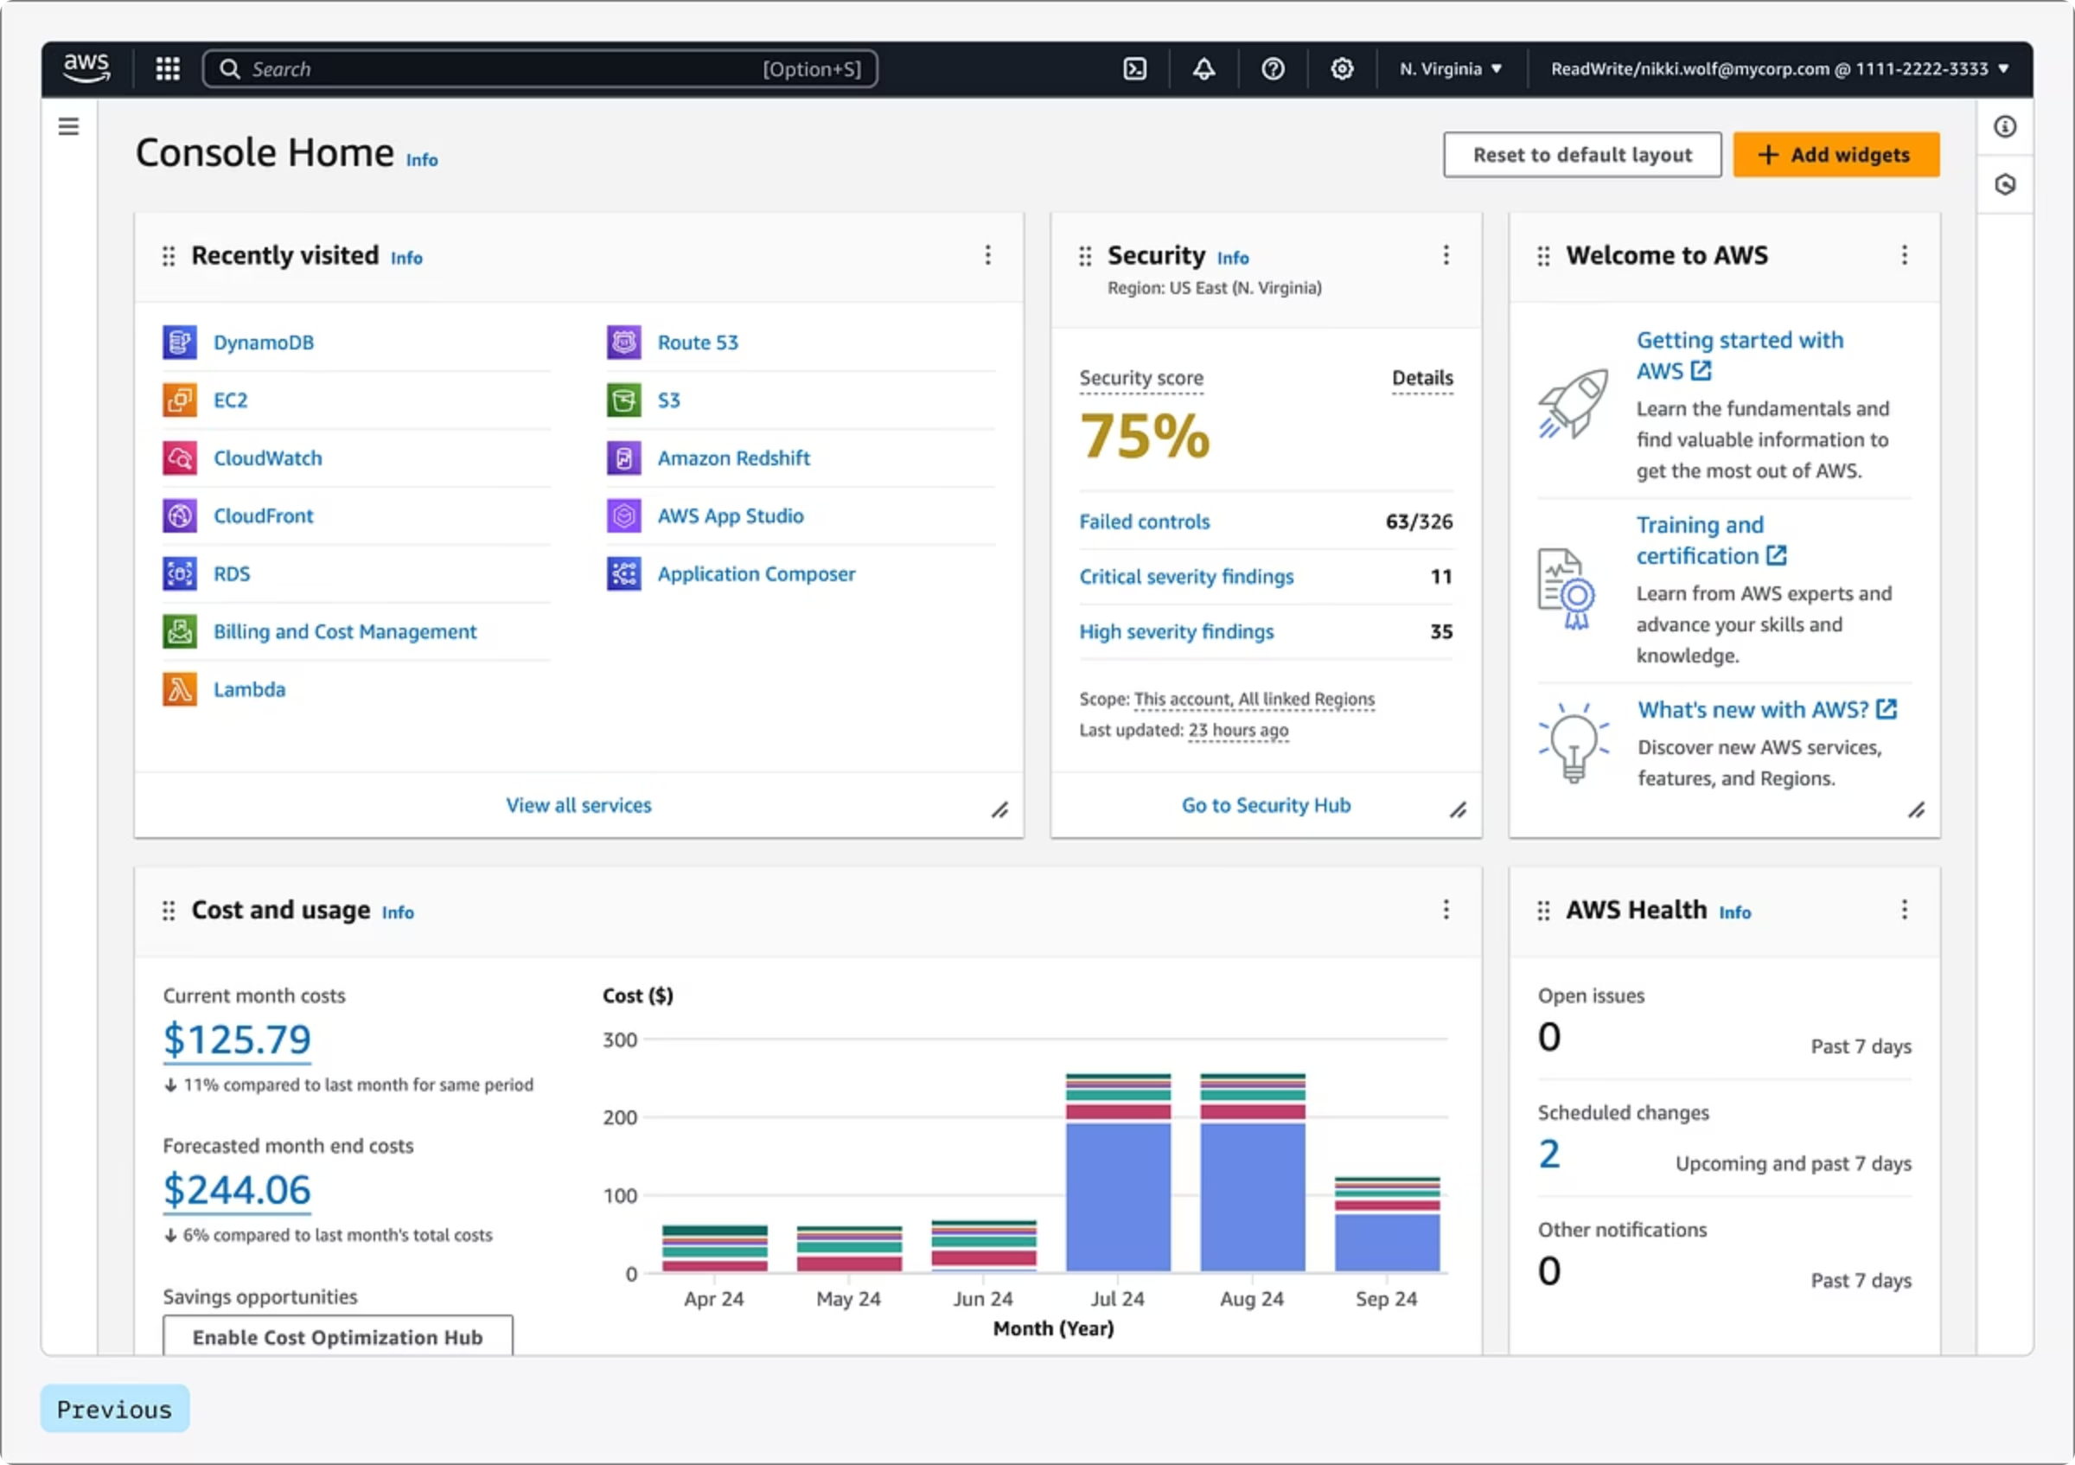
AWS Account Creation, Console Walkthrough, Practical Demo
Now that we've covered the foundational concepts, it's time to get hands-on. This section will guide you through setting up your AWS environment and taking your first steps with Amazon Bedrock.
AWS Account Setup
Learn the essential steps for creating a new AWS account, including billing setup and verifying your identity, to ensure you're ready to deploy services.
Console Navigation & Bedrock Access
Familiarise yourself with the AWS Management Console. We'll specifically navigate to the Amazon Bedrock service page and explore its various features and configurations.
First Practical Demo
Engage in a practical demonstration, where you'll interact directly with a Foundation Model in Bedrock. We'll cover sending prompts and interpreting model outputs for real-world scenarios.

Slide 35
Bedrock Best Practices
To maximise efficiency, accuracy, and cost-effectiveness in your Generative AI applications on AWS Bedrock, consider these essential guidelines.
Use the Right Model
Control Output Behavior
Keep Prompts Short but Clear
Different models excel at distinct tasks. Choose a model optimised for your specific need, whether it's complex reasoning, rapid generation, or creative output.
Adjust parameters like Temperature and Top-P to fine-tune the model's output. Higher temperature for creative tasks, lower for technical accuracy and consistency.
Craft concise yet explicit prompts. Long or ambiguous prompts can confuse models, lead to irrelevant responses, and increase processing costs.
Structure Your Workflow
Secure Everything with IAM
Utilise distinct system, user, and assistant prompts to guide the model. This structured approach enhances consistency and predictability in its responses.
Implement AWS IAM policies to grant the least privilege necessary. Limit permissions only to the services and resources required for your GenAI solution.

Slide 36
Common Pitfalls to Avoid
Navigating the Amazon Bedrock ecosystem requires awareness of common missteps. Avoiding these pitfalls will ensure more secure, efficient, and accurate Generative AI implementations.
Using Root User for Day-to-Day Work
Confusing Model Types
Sending Poor-Quality Documents in RAG
Remember that text generation models excel at language tasks, image models at visual creation, and embedding models at semantic understanding. Misusing them leads to suboptimal results.
Always switch to IAM users for regular operations to mitigate significant security risks and adhere to the principle of least privilege. The root user account has unrestricted access.
The effectiveness of Retrieval-Augmented Generation (RAG) is directly tied to data quality. Ensure your knowledge base documents are clean, well-structured, and easily parsable to maximise accuracy.
Overusing High Temperatures
Expecting the Model to "Know" Internal Info
While high temperatures foster creativity, relying on them too heavily for critical applications can result in unreliable, inconsistent, or even hallucinated responses from your LLM.
Foundation models do not have inherent access to your private or proprietary data. You must explicitly provide this context through Knowledge Bases or in-prompt data for relevance.

Slide 37
Final Summary
You've journeyed through the core concepts of Generative AI and seen how AWS Bedrock simplifies its implementation. Here's a recap of what you've mastered:
1
Generative AI, Foundation Models, & LLMs
Grasped the fundamental definitions and distinctions of these powerful AI paradigms.
2
Tokens, Context Length, & Parameters
Understood the critical elements that dictate LLM behaviour and output.
3
AWS Bedrock Fundamentals
Learned how Bedrock serves as a fully managed service for building and scaling GenAI applications.
4
Model Categories on Bedrock
Explored the capabilities of text, image, and embedding models available on the platform.
5
Knowledge Bases & RAG
Understood how Retrieval-Augmented Generation (RAG) leverages knowledge bases for factual, up-to-date responses.
6
Bedrock Agents for Automation
Discovered how Agents orchestrate multi-step tasks and integrate with backend systems.
7
AWS Service Integration
Reviewed the roles of IAM, S3, Lambda, and EC2 in comprehensive GenAI architectures.
8
Prompting Strategies & Best Practices
Acquired techniques for crafting effective prompts and adhering to best practices for optimal performance.
Conclusion: With this comprehensive understanding, you are now equipped to confidently build, deploy, and manage cutting-edge Generative AI solutions on AWS Bedrock. The future of AI innovation is in your hands!

Slide 38
Key Takeaway
AWS Bedrock: Your Foundation for Effortless GenAI Innovation.
AWS Bedrock truly simplifies the complex world of Generative AI development. It abstracts away the heavy lifting of managing underlying foundation models, offering a fully managed service that ensures your applications are not just innovative, but also inherently secure, scalable, and ready for production environments. This means you can focus entirely on building groundbreaking GenAI solutions without the burden of infrastructure complexities.
With Bedrock, you're not just using AI; you're building with it, empowered by the robust, reliable, and flexible infrastructure of AWS.

